Slide 1
H1B CASE STUDY USING HADOOP ECOSYSTEM
presented by:
Name: Ajit Maharudra Salgare
Student ID: S171107500151
Center: Pune Deccan

Slide 2
Objective
To provide analysed report to H1B Spongers to help them to make plans for future H1visa policy.

Slide 3
Big Data
Big data means really a big data, it is a collection of large datasets that cannot be processed using traditional computing techniques.
Data which are very large in size is called Big Data. Normally we work on data of size MB(Word-Doc ,Excel) or maximum GB(Movies, Codes) but data in Peta bytes i.e. 10^15 byte size is called Big Data.

Slide 4
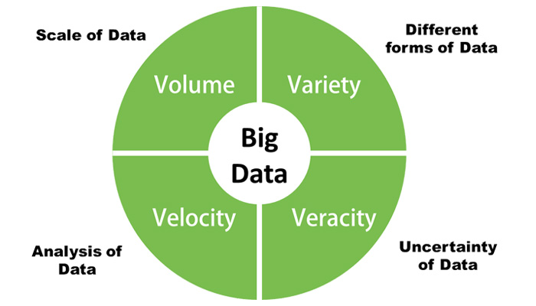
Hadoop 4v of Big Data

Slide 5
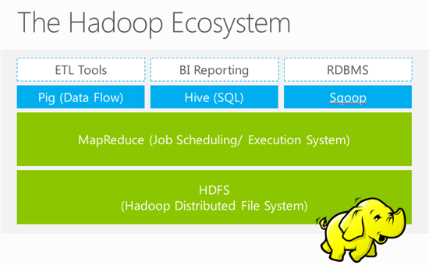
Hadoop Ecosystem

Slide 6
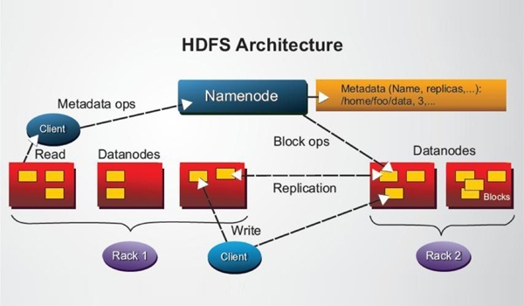
HDFS Architecture

Slide 7
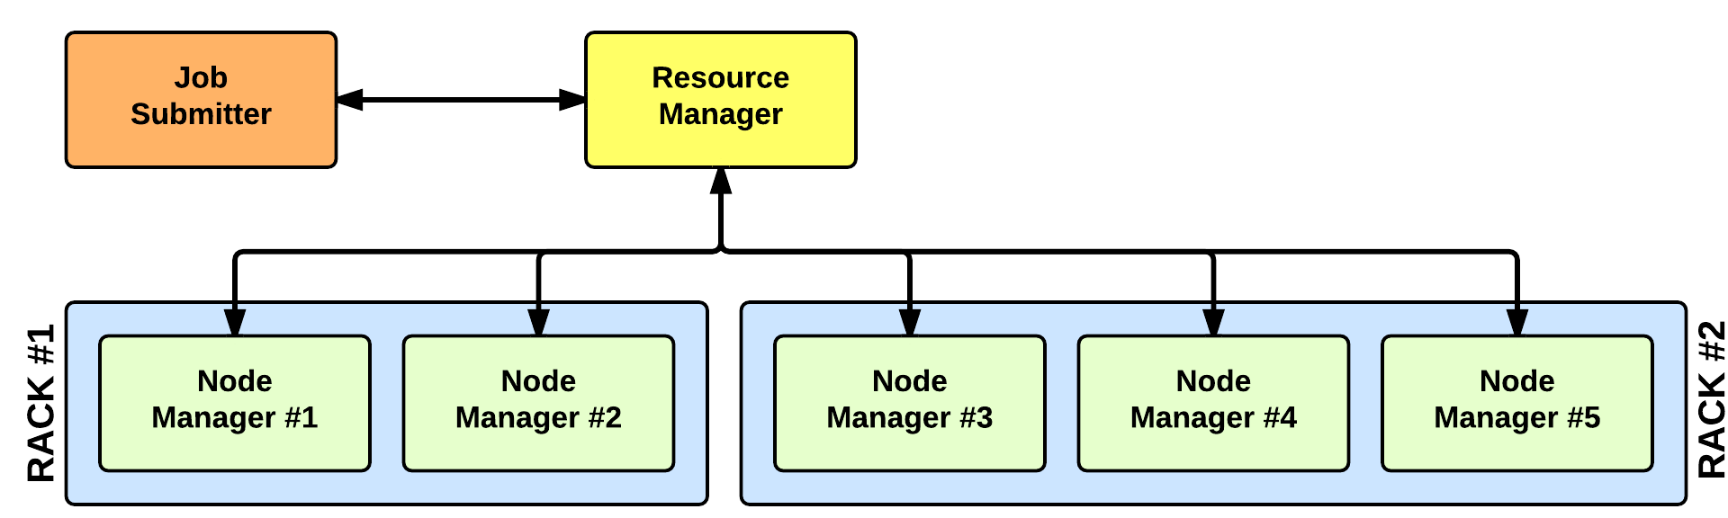
YARN Architecture

Slide 8
Advantages of Hadoop
Fast: In HDFS the data distributed over the cluster and are mapped which helps in faster retrieval. Even the tools to process the data are often on the same servers, thus reducing the processing time. It is able to process terabytes of data in minutes and Peta bytes in hours.
Scalable: Hadoop cluster can be extended by just adding nodes in the cluster.
Cost Effective: Hadoop is open source and uses commodity hardware to store data so it really cost effective as compared to traditional relational database management system.

Slide 9
Technology used
MapReducer : a parallel processing software framework. It is comprised of two steps. Map step is a master node that takes input and partitions them into smaller sub-problems and then distributes them to worker nodes. After the map step has taken place, the master node takes the answer to all of the sub-problems and combines them to produce output.
Hive : a data warehousing and SQL like query language that presents the data in the form of tables. Hive programming is similar to data Warehousing.
Pig : a platform for manipulating data stored in HDFS and that includes a compiler for map reduce programs and high level language called Pig Latin.it provides a way to perform data extractions, transformation and loading and basic analysis without having to write Map Reduce programs.
Sqoop : a connection and transfer mechanism that moves the data between hadoop and relational databases

Slide 10
Analyzing Factors
we will be performing analysis on the H1B visa applicants between the years 2011-2016. After analyzing the data, we can derive the following facts.
1 a) Is the number of petitions with Data Engineer job title increasing over time?
b) Find top 5 job titles who are having highest avg growth in applications.[ALL]
2 a) Which part of the US has the most Data Engineer jobs for each year?
b) find top 5 locations in the US who have got certified visa for each year.[certified]
3)Which industry(SOC_NAME) has the most number of Data Scientist positions?
4)Which top 5 employers file the most petitions each year? - Case Status - ALL
5) Find the most popular top 10 job positions for H1B visa applications for each year?
a) for all the applications
b) for only certified applications.

Slide 11
Analyzing Factors
6) Find the percentage and the count of each case status on total applications for each year. Create a line graph depicting the pattern of All the cases over the period of time.
7) Create a bar graph to depict the number of applications for each year [All]
8) Find the average Prevailing Wage for each Job for each Year (take part time and full time separate). Arrange the output in descending order - [Certified and Certified Withdrawn.]
9) Which are the employers along with the number of petitions who have the success rate more than 70% in petitions. (total petitions filed 1000 OR more than 1000) ?
10) Which are the job positions along with the number of petitions which have the success rate more than 70% in petitions (total petitions filed 1000 OR more than 1000)?
11) Export result for question no 10 to MySql database

Slide 12
1 a) Is the number of petitions with Data Engineer job title increasing over time?
Ans:
(77.0%)
(28.0%)
(117.0%)
(79.0%)
(56.0%)

Slide 13
1 b) Find top 5 job titles who are having highest avg growth in applications.[ALL]
(SENIOR SYSTEMS ANALYST JC60,4229.8)
(SOFTWARE DEVELOPER 2,3382.8)
(MODULE LEAD,3195.2)
(SYSTEMS ANALYST JC65,2969.8)
(LEAD,2507.0)

Slide 14
2 a) Which part of the US has the most Data Engineer jobs for each year?
Ans:
((DATA ENGINEER,SAN FRANCISCO, CALIFORNIA,2011),3)
((DATA ENGINEER,SAN FRANCISCO, CALIFORNIA,2012),7)
((DATA ENGINEER,MENLO PARK, CALIFORNIA,2013),10)
((DATA ENGINEER,MENLO PARK, CALIFORNIA,2014),13)
((DATA ENGINEER,SAN FRANCISCO, CALIFORNIA,2015),33)
((DATA ENGINEER,MENLO PARK, CALIFORNIA,2016),35)

Slide 15
2 b) find top 5 locations in the US who have got certified visa for each year.[certified]
Year 2011
((NEW YORK, NEW YORK,CERTIFIED,2011),23172)
((HOUSTON, TEXAS,CERTIFIED,2011),8184)
((CHICAGO, ILLINOIS,CERTIFIED,2011),5188)
((SAN JOSE, CALIFORNIA,CERTIFIED,2011),4713)
((SAN FRANCISCO, CALIFORNIA,CERTIFIED,2011),4711)

Slide 16
3)Which industry(SOC_NAME) has the most number of Data Scientist positions? [certified]
Ans:
STATISTICIANS 369
COMPUTER AND INFORMATION RESEARCH SCIENTISTS 283
OPERATIONS RESEARCH ANALYSTS 237
Computer and Information Research Scientists 115
COMPUTER OCCUPATIONS, ALL OTHER 113
MATHEMATICIANS 107

Slide 17
4)Which top 5 employers file the most petitions each year? - Case Status - ALL
Year 2016
PROGRAMMER ANALYST 2016 53743
SOFTWARE ENGINEER 2016 30668
SOFTWARE DEVELOPER 2016 14041
SYSTEMS ANALYST 2016 12314
COMPUTER PROGRAMMER 2016 11668

Slide 18
5) Find the most popular top 10 job positions for H1B visa applications for each year?
Year 2012
PROGRAMMER ANALYST 33066 2012
SOFTWARE ENGINEER 14437 2012
COMPUTER PROGRAMMER 9629 2012
SYSTEMS ANALYST 9296 2012
BUSINESS ANALYST 4752 2012
COMPUTER SYSTEMS ANALYST 4706 2012
SOFTWARE DEVELOPER 3895 2012
PHYSICAL THERAPIST 3871 2012
ASSISTANT PROFESSOR 3801 2012
SENIOR CONSULTANT 3737 2012

Slide 19
6) Find the percentage and the count of each case status on total applications for each year. Create a line graph depicting the pattern of All the cases over the period of time.
Ans:
2011 358767 307936 85.83175152675692 11596 3.2321813321738064 10105 2.816591269542628 29130 8.119475871526644
2012 415607 352668 84.85612609989725 31118 7.487361858678993 10725 2.5805628875355806 21096 5.0759491538881685
2013 442114 382951 86.61815730784367 35432 8.014222576077664 11590 2.621495813297023 12141 2.7461243027816358
2014 519427 455144 87.62424748809747 36350 6.99809597883822 16034 3.086863024063054 11899 2.2907935090012645
2015 618727 547278 88.45225761927313 41071 6.637984119005635 19455 3.144359305477214 10923 1.7653989562440302
2016 647803 569646 87.93506667922193 47092 7.269493966529948 21890 3.3791137120389996 9175 1.4163256422091284

Slide 20
7) Create a bar graph to depict the number of applications for each year [All]
Technology used: mapreduce
Ans:

Slide 21
8) Find the average Prevailing Wage for each Job for each Year (take part time and full time separate). Arrange the output in descending order - [Certified and Certified Withdrawn.]
Year 2012
9853122.909 2012 (ASSOCIATE SQA ENGINEER,Y)
9491354 2012 (TEACHER (MATHEMATICS),Y
9422870 2012 (SENIOR AUDIT ASSOCIATE,Y)
9078950 2012 (ELEMENTARY SCHOOL SPANISH TEACHER,Y)
8976796.8 2012 (DATA ADMINISTRATOR,N
8831672.062 2012 (SENIOR FINANCE MANAGER,Y)
8453338.3 2012 (PRINCIPAL ARCHITECT,Y)

Slide 22
9) Which are the employers along with the number of petitions who have the success rate more than 70% in petitions. (total petitions filed 1000 OR more than 1000) ?
Ans:
"THE UNIVERSITY OF IOWA" 1569 70.554493 %
"VERINON TECHNOLOGY SOLUTIONS LTD.", 1245 70.923695 %
"GENESIS ELDERCARE REHABILITATION SERVICES 1458 71.330590 %
"DEUTSCHE BANK SECURITIES INC." 1170 71.880342 %
"SUNERA TECHNOLOGIES 1464 72.131148 %
"GENERAL HOSPITAL CORPORATION" 1429 72.288314 %

Slide 23
10) Which are the job positions along with the number of petitions which have the success rate more than 70% in petitions (total petitions filed 1000 OR more than 1000)?
Ans:
"TEST ANALYST - US" 1023 100.000000 %
"ASSOCIATE CONSULTANT - US" 4392 99.908925 %
"PRODUCTION SUPPORT ANALYST - US" 1451 99.862164 %
"SYSTEMS ENGINEER - US" 10026 99.840415 %
"CONSULTANT - US" 7413 99.797653 %

Slide 24
Conclusion:

Slide 25
Thank You

